Slide 1

Course Code: BCSE498J Course Name: Project-II Title: Alzheimer’s Disease Diagnosis and Progression Level Tracking Using MRI Data
Member 1- Anuska Bose(21BCT0002)
Member 2- Garvit Rastogi(21BCT0034)
Guide Name – Prof. Dr. Dheeba J

Slide 2
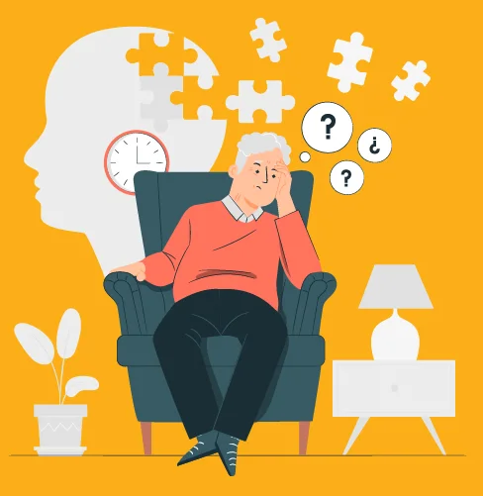
What Is Alzheimer’s Disease?
Alzheimer’s disease is a brain disorder that slowly destroys memory and thinking skills. People with Alzheimer’s also experience changes in behavior and personality.
The symptoms of Alzheimer’s disease — changes in thinking, remembering, reasoning, and behavior — are known as dementia. Other diseases and conditions can also cause dementia, with Alzheimer’s being the most common cause of dementia in older adults.
Alzheimer’s disease is not a normal part of aging. It’s the result of complex changes in the brain that start with years before symptoms appear and lead to the loss of brain cells and their connections.

Slide 3
AIM
The primary aim of this project is to develop and evaluate machine learning models capable of accurately predicting the progressive levels of Alzheimer's Disease (AD).
Utilizing the rich multimodal data available within the NACC-UDS dataset – encompassing MRI-derived volumetric measures, comprehensive clinical assessments, and genetic information, we seek to create predictive tools that can aid in early diagnosis and facilitate personalized treatment strategies.
A crucial objective is to identify the key predictive features contributing to AD progression, which can enhance our understanding of the underlying disease mechanisms and inform the development of more targeted interventions, as determined by the highest F1-score.
By combining a variety of features to train different models, we ensure that the most performant model is selected for accurate AD prediction.

Slide 4
Outlines/Content
Introduction
Literature Review
Problem Formulation
Relevance of the problem statement w.r.t SDG
Proposed System/Architecture/Design
Analytical and Theoretical Description
Hardware/Software tools and Simulation/Design Parameters
Results analysis
Conclusion
Contribution of individual Team members
Impact of the project on society and environment
References (Major)

Slide 5

INTRODUCTION
Alzheimer's Disease (AD) represents a significant and growing global health challenge, characterized by progressive cognitive decline and neurodegeneration.
Early and accurate prediction of AD progression is essential for timely intervention, improved patient management, and the development of effective therapies.
This project addresses the critical need for robust diagnostic tools by leveraging machine learning techniques applied to the NACC-UDS dataset. By integrating MRI data with clinical and genetic information.
We aim to develop predictive models that can identify individuals at high risk of AD progression, enabling earlier interventions and personalized treatment strategies that improve patient outcomes and reduce the burden on healthcare systems.
The focus of this data-driven approach is to go beyond binary AD classification, and predict progressive levels of the disease, and give an interpretable model for decision-making.

Slide 6

OBJECTIVES
The primary objectives of this project are:
To develop machine-learning models that can accurately predict the progressive levels of Alzheimer's Disease using the NACC-UDS dataset.
To evaluate the performance of various classification algorithms, including Logistic Regression, Random Forest, XGBoost, LightGBM, CatBoost, and MLP classifiers, using the F1-score metric.
To investigate the added value of combining multimodal data sources, such as MRI data with cognitive and neuropsychiatric assessments, for predicting AD progression.
To identify the most important features driving AD progression and provide insights into the underlying mechanisms of the disease.
To create an interpretable machine learning model to predict stages of Alzheimer's and the factors that drive it.

Slide 7
LITERATURE REVIEW
Alzheimer's Disease (AD) research has greatly advanced our understanding of this complex disease.
Studies using MRI have shown that brain structures like the hippocampus shrink in AD patients.
Other research has found a link between brain shrinkage and cognitive decline. Genetic factors, particularly a gene called APOE4, also increase the risk of AD.
To better predict AD, studies combine MRI scans with patient clinical and cognitive data.
With sophisticated machine learning algorithms, researchers are now able to find patterns indicative of AD.
Our project builds upon these findings, aiming to improve AD prediction accuracy by using machine learning and combining various types of patient data.

Slide 8

RESEARCH GAPS
Beyond Simple Diagnosis: Most studies only predict if someone has Alzheimer's, not how severe it is. We want to predict the different stages of the disease.
Need for Better Models: Existing models aren't always accurate for everyone due to the complex nature of Alzheimer's. We need models that work better across different people.
Combining Data: Few studies look at how combining MRI scans with patient history and test results improves prediction. We'll use all available data.
Understanding Key Factors: We need to know why certain factors lead to Alzheimer's progression. We aim to create models that can explain what's driving the disease.
Interpretable Model: We need simple model to show important features with their risk or protective score.

Slide 9

Problem Formulation
Predict the severity level (0-3) of Alzheimer's Disease using MRI data.
Using a dataset from the NACC (Uniform Data Set).
Data includes MRI results and patient information.
Levels indicate the stage/progression of Alzheimer’s.
Using machine learning to predict disease level.
Model will classify patients into one of the Alzheimer's levels.
Model performance will be evaluated using the F1-Score.
The dataset has an unequal distribution of patients across the different levels.
Libraries like Python, Pandas, NumPy, Matplotlib are used.
Develop a complete data science models to accurately determine the level of Alzheimer’s disease.

Slide 10

Relevance of the Problem Statement w.r.t SDG
SDG 3: Good Health and Well-being: Addressing Alzheimer's Disease (AD) through early diagnosis and progression tracking, as highlighted in our project, directly contributes to SDG 3. AD significantly impacts the health and well-being of older adults, and our predictive models can aid in timely interventions to improve patient outcomes.
SDG 9: Industry, Innovation, and Infrastructure: Our project aligns with SDG 9 by fostering innovation in healthcare through the application of machine learning to medical imaging data. The development of advanced diagnostic tools supports technological progress and infrastructure improvements in healthcare.
SDG 10: Reduced Inequalities: As AD disproportionately affects aging populations, particularly those with limited access to healthcare, our work aims to reduce inequalities by enabling more accurate and accessible diagnostic methods, regardless of geographical location or socioeconomic status.
Overall Impact: Early and accurate prediction of Alzheimer's progression enhances patient care, reduces the burden on healthcare systems, and supports the development of targeted interventions, all contributing to the broader goals of sustainable development and improved quality of life.

Slide 11
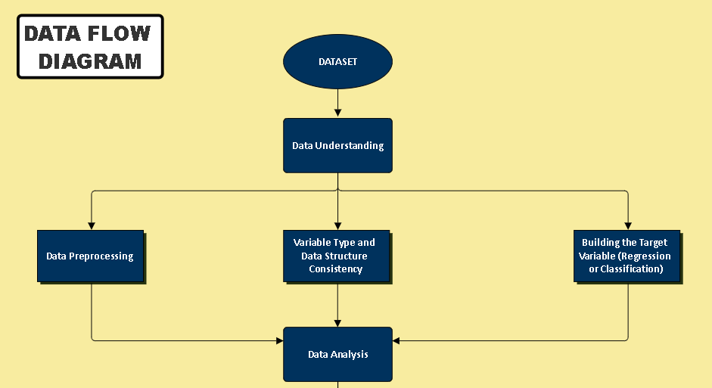
Proposed System/Architecture/Design
WORKFLOW MODEL (Data Flow Diagram)

Slide 12
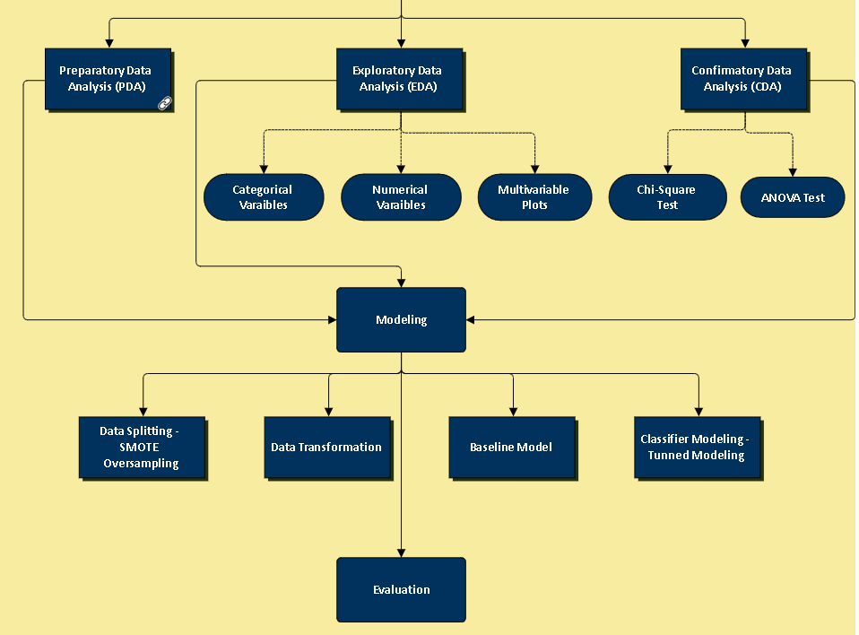
WORKFLOW MODEL (Data Flow Diagram)

Slide 13
Analytical and Theoretical Description
In this project, it is necessary to provide an end-to-end data science model to determine the level of Alzheimer’s disease.
Levels are categorized in order from low to high: 0,1,2,3. (these are the progressive levels of Alzheimer’s disease).
1. Data Understanding
1.2 Data Short Information:
The dataset is provided by the NACC – Uniform Data Set by the University of Washington. In addition, the Genetic Data Dictionary and Imaging Data Dictionary are used to determine MRI terms.
The train dataset size should be 70%, the validation dataset size 15% as well as the test size 15%. The target metric will be F1-Score.

Slide 14
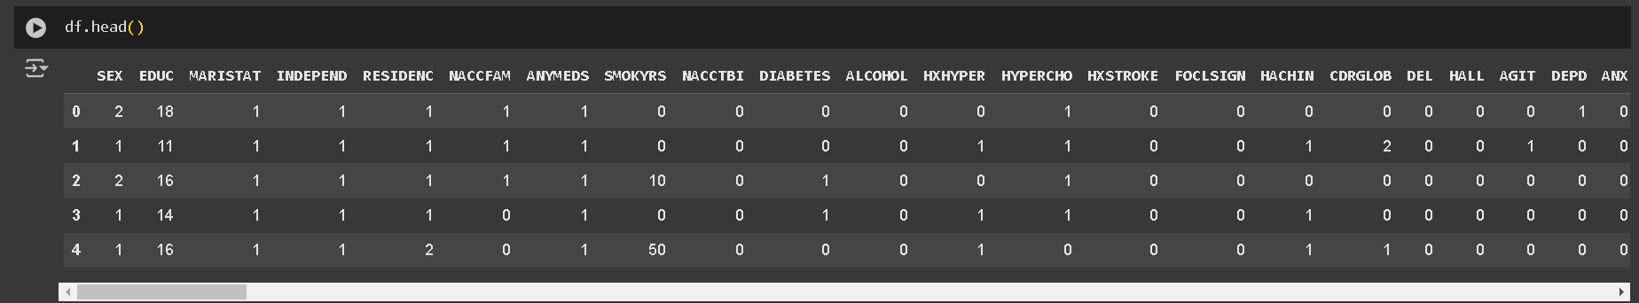
1.2 Types of Libraries:
The code is written in Python and it is aimed to use NumPy, and Pandas libraries in this data analysis part, Matplotlib in the data visualization.
1.3 Data Preprocessing:
The data equals (1354, 186). The first 5 rows of the dataset look like this.

Slide 15
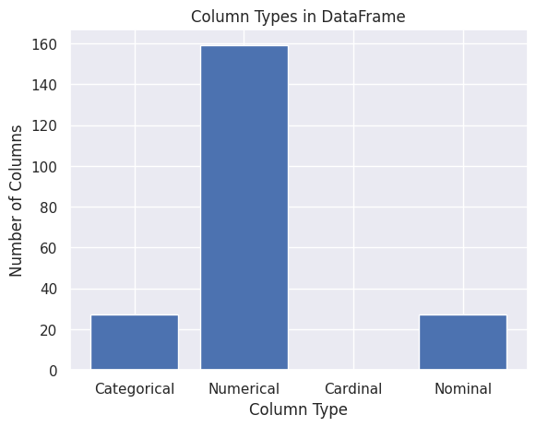
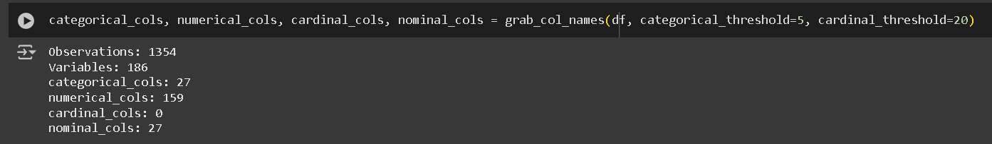
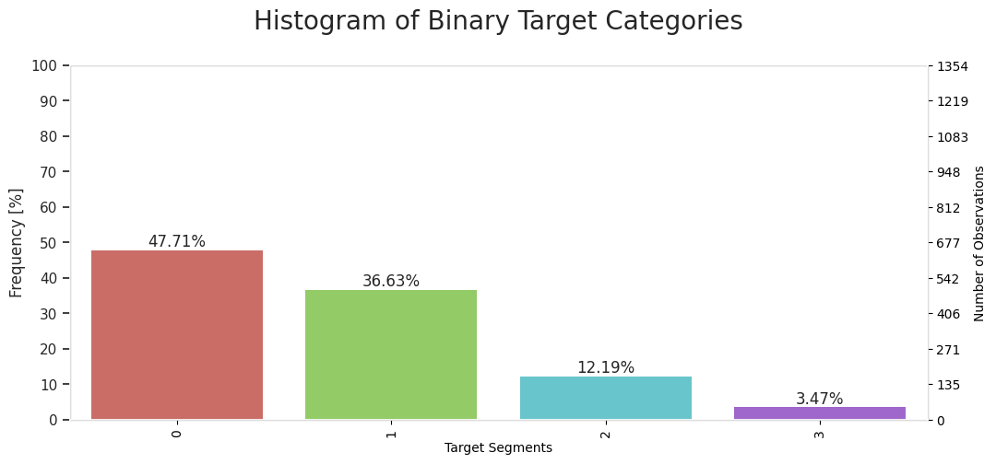
1.4 Variable Type and Data Structure Consistency
In the model phase, categorical, numerical, cardinal, and nominal columns are determined to approach all kinds of data more accurately. A total of 27 categorical features, 159 numerical features, and 27 nominal features are determined.
1.5 Building the Target Variable (Regression or Classification):
To understand what kind of model should be built, visualization is done to better understand the CDRGLOB Clinical Dementia Rating - Global score (Overall level of cognitive impairment) feature, which is determined as the target feature. As a result, it is determined that modeling with classification is required and there is an unbalanced data set.

Slide 16
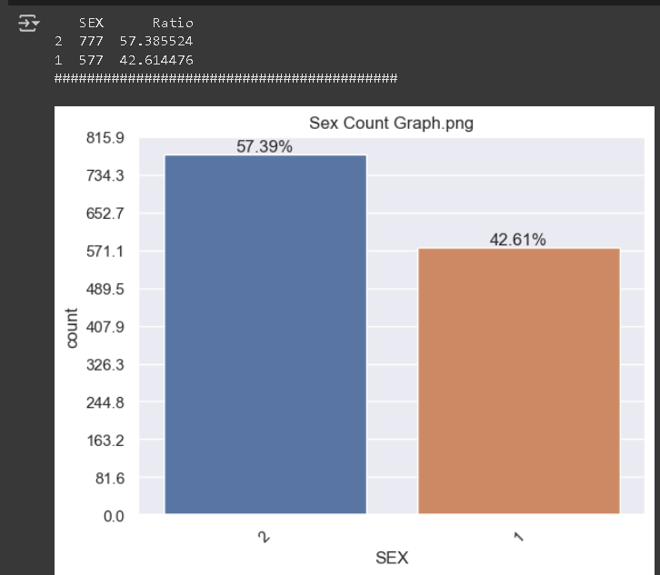
2. Data Analysis
2.1 Exploratory Data Analysis (EDA)
2.1.1 Categorical Variables
• Looking at the gender distribution of the patients in the data, it is observed that the male population was more.
• More than 87% of patients in the data have the following characteristics:
Living alone
Using drugs,
Alcohol consumption,
No history of traumatic brain injury, no diabetes, no focal neurological symptoms
• Looking at the relationship between the categorical features and the target feature (CDRGLOB),
the following features are those that cause serious impairment in Alzheimer's disease:
Completely dependent
Staying in a hospital or nursing home,
Eating disorder, increased nighttime behavior, motor disorder, irritability, instability, apathy, anxiety, depression, hallucinations in the last month,
Being a drug user

Slide 17
2.1.2 Numerical Variables
Visualization is done for each numerical feature using a histogram. As a result of this analysis, the following comments are obtained.
Considering the relationship between the numerical features and the target feature (CDRGLOB), the following features are the ones that cause severe impairment in Alzheimer’s disease.
• Total years of smoking
• Patient’s age at the first visit,
• Total brain white matter hyperintense volume^1
• Total cerebrospinal fluid volume^2
• Segmented left / right lateral ventricle volume (cc)^3
• Segmented total third ventricle volume (cc)

Slide 18
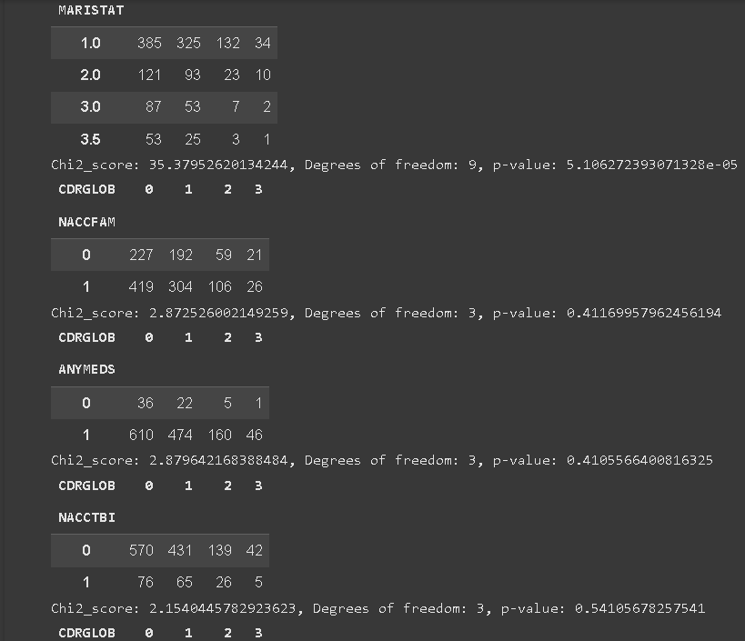
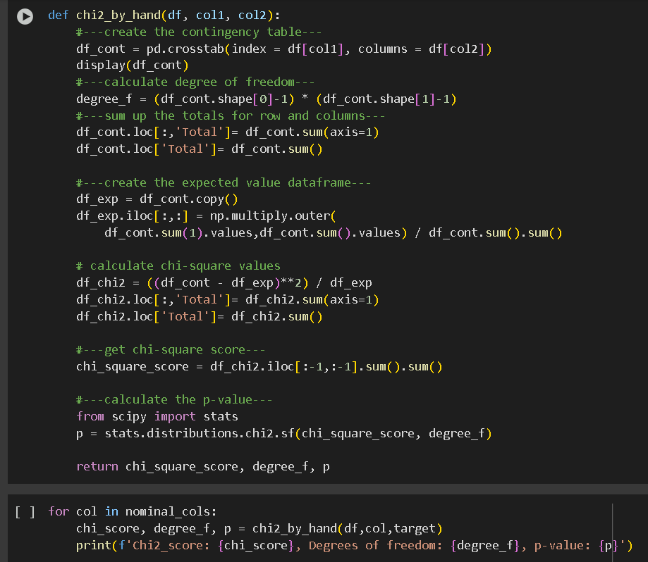
2.2 Confirmatory Data Analysis (CDA)
2.2.1 Chi-Square test for Nominal Features: Chi-Square test is performed on all nominal properties to see if there is a high correlation.
In conclusion, since all other features except ANYMEDS have p values <0.05, it can be concluded that these features are related to the CDRGLOB target and should be included in your model for training.

Slide 19
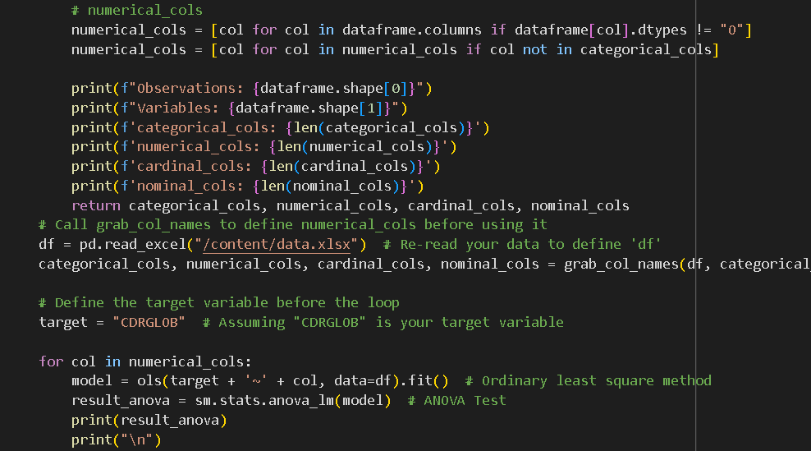
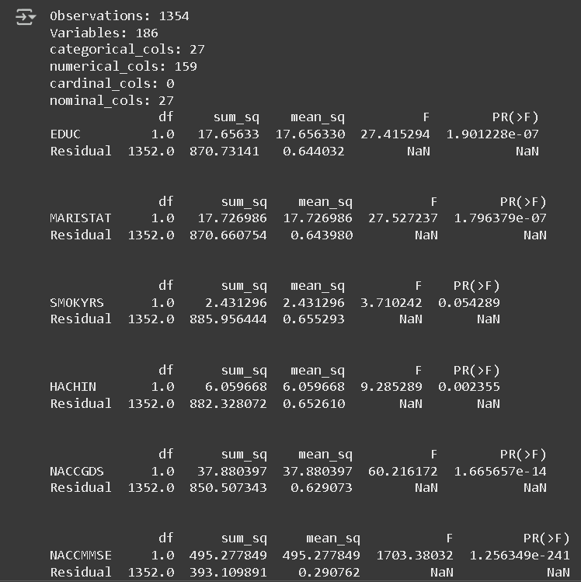
2.2.2 ANOVA Test for Numerical Features: The significance value is accepted as 0.05. If the p-value < 0.05, we assume that there are significant differences in the mean of the groups formed by each level of the categorical data. That is, we reject the NULL hypothesis.
In this case, it can be concluded that the numerical features of SMOKYRS, NACCICV, LPARSOPM should not be included in the model since their p value is greater than 0.05. Hence, we delete these columns from dataset for further modeling.

Slide 20
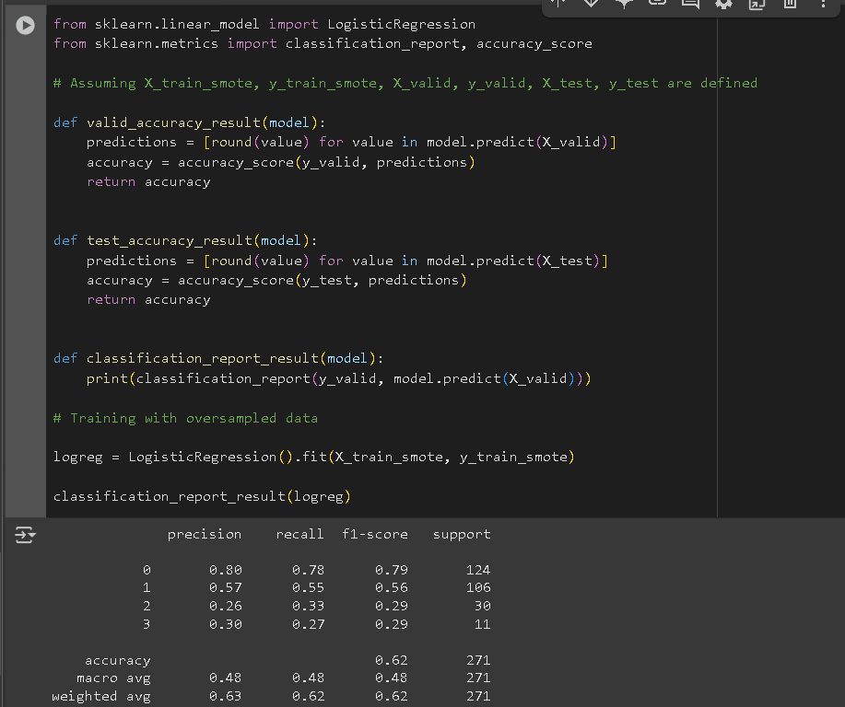
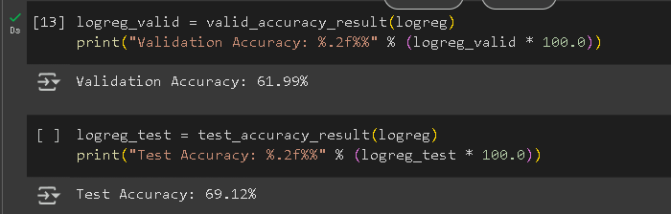
3. Modeling
3.1 Logistic Regression Classifier
The model achieved a validation accuracy of 61.99% and test accuracy of 69.12%. The classification report indicates moderate class imbalance, with varying precision and recall across classes—particularly low for classes 2 and 3. The overall macro and weighted F1-scores are around 0.48 and 0.62, respectively, reflecting moderate performance.

Slide 21
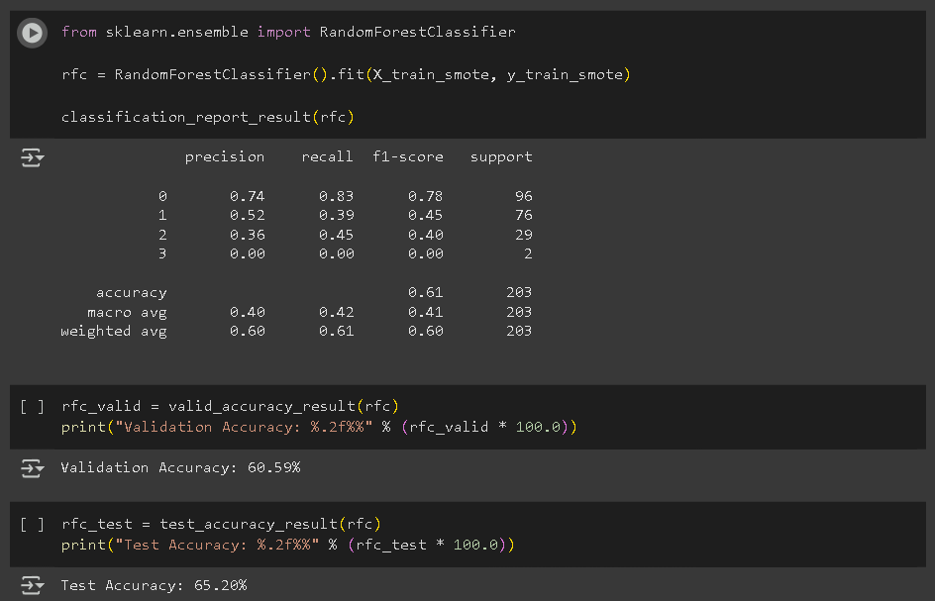
3.2 Random Forest Classifier
It achieved a validation accuracy of 60.59% and test accuracy of 65.20%. The model performed best on class 0, but struggled with minority classes, especially class 3 (f1-score = 0.00), indicating a challenge with class imbalance. Overall, it shows moderate performance with a weighted F1-score of 0.60.

Slide 22
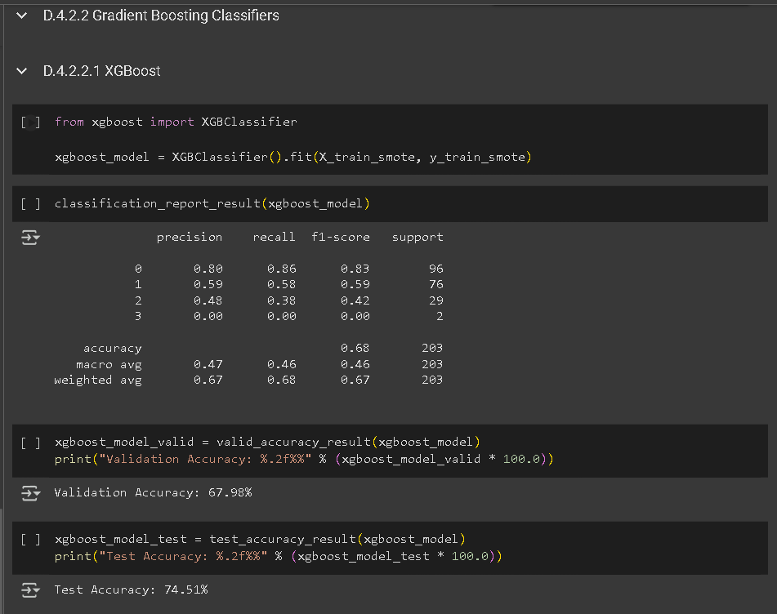
3.3 Gradient Boosting Classifiers
3.3.1 XGBoost
It achieved a validation accuracy of 67.98% and a test accuracy of 74.51%, the highest among the models compared.
Class 0 showed strong performance, but class 3 was completely misclassified.
Despite class imbalance issues, the model showed better overall performance with a weighted F1-score of 0.67.

Slide 23
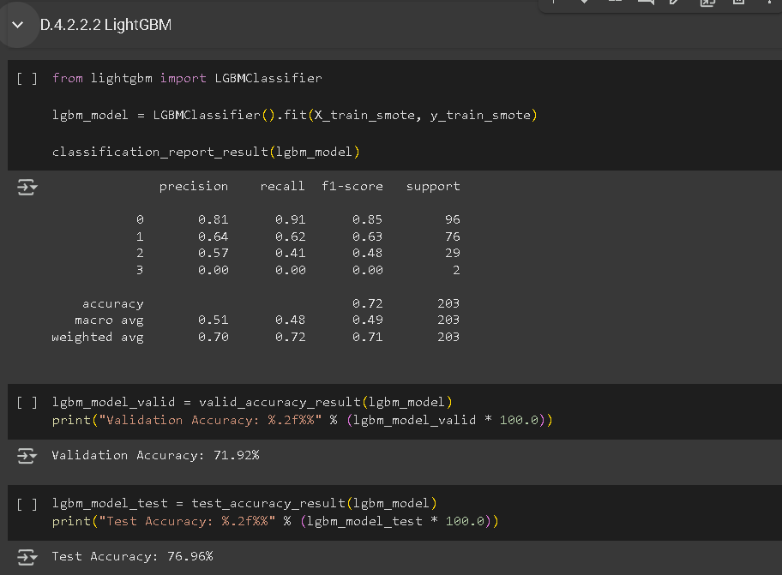
3.3 Gradient Boosting Classifiers
3.3.2 LightGBM
The LightGBM Classifier performed best overall, achieving a validation accuracy of 71.92% and the highest test accuracy of 76.96%.
It handled classes 0, 1, and 2 better than previous models, with class 0 showing the strongest results (F1-score: 0.85).
However, class 3 remained unclassified. Its weighted F1-score of 0.71 indicates solid overall performance.

Slide 24
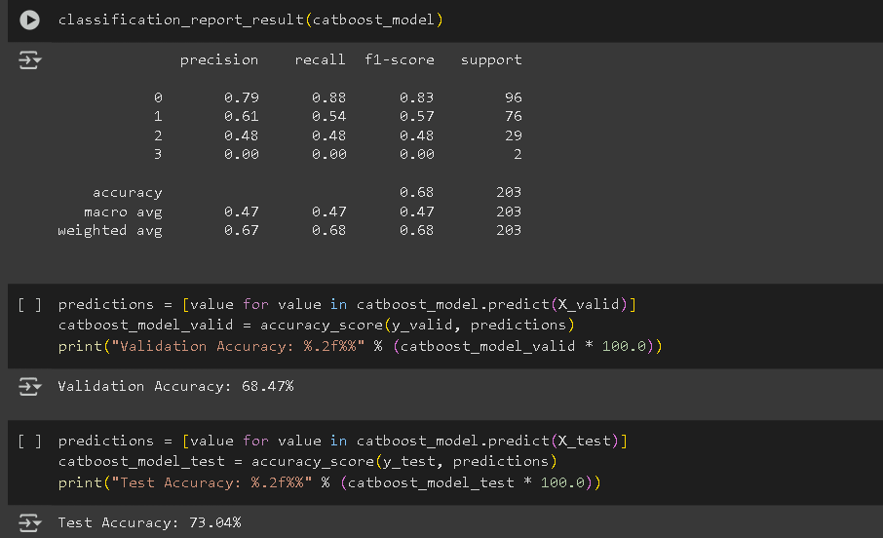
3.3 Gradient Boosting Classifiers
3.3.3 CatBoost
The CatBoost Classifier achieved a validation accuracy of 68.47% and a test accuracy of 73.04%.
It performed well on class 0 (F1-score: 0.83), but struggled with class imbalance, especially for class 3, which it couldn't predict.
Overall, the macro and weighted F1-scores (0.47 and 0.68) indicate moderate performance with room for improvement in minority class handling.

Slide 25
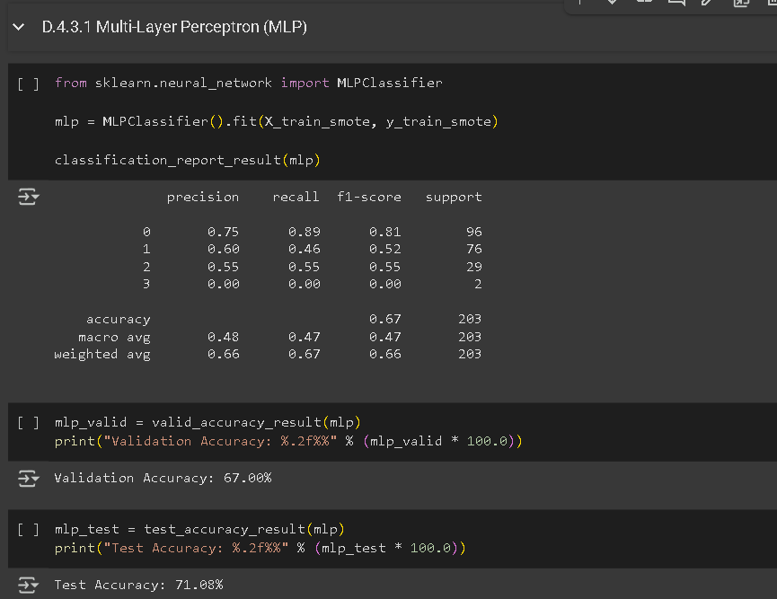
3.4 Neural Network Classifiers
3.4.1 Multi-Layer Perceptron (MLP)
The MLP Classifier achieved a validation accuracy of 67.00% and a test accuracy of 71.08%.
It performed best on class 0 (F1-score: 0.81), while struggling with class 3 (F1-score: 0.00).
The macro and weighted F1-scores (0.47 and 0.66) indicate moderate overall performance, but like the other models, it faces difficulty handling minority classes effectively.

Slide 26
HARDWARE AND SOFTWARE SPECIFICATION
HARDWARE SPECIFICATIONS
Category | Specification | Notes
Processor | Virtualized CPU (Intel Xeon or similar) | Google Colab provides a shared, virtualized CPU environment. The specific CPU model may vary.
RAM | 12 GB - 16 GB (Variable) | The amount of RAM allocated to a Colab notebook can vary based on resource availability and usage.
Disk Space | Approximately 70 GB | Colab provides a virtualized disk space for storing data, models, and other files.
GPU (Optional) | NVIDIA Tesla K80, T4, P100, or similar | Colab offers free GPU acceleration, but the availability of specific GPUs varies based on demand and subscription level (Colab Pro/Pro+ may offer better GPU options).
Execution Environment | Cloud-based Virtual Machine | The code is executed on a remote virtual machine hosted by Google.

Slide 27
SOFTWARE SPECIFICATIONS
Category | Software/Library | Notes
Operating System | Linux (Debian or Ubuntu) | Google Colab uses a Linux-based operating system.
Programming Language | Python | The primary programming language used in the project.
Data Analysis | Pandas | Used for data manipulation and analysis.
 | NumPy | Used for numerical computations.
Visualization | Matplotlib | Used for creating plots and visualizations.
 | Seaborn | Used for enhanced statistical visualizations.

Slide 28
Category | Software/Library | Notes
Machine Learning | Scikit-learn | Used for various machine learning algorithms, model evaluation, and data preprocessing.
 | LightGBM | Used for gradient boosting.
 | XGBoost | Used for gradient boosting.
 | CatBoost | Used for gradient boosting.
 | TensorFlow | Potentially used for building neural networks (though not heavily emphasized in the notebook).
 | Keras | High-level API for building and training neural networks (used if TensorFlow is employed).
Other Libraries | Imblearn (SMOTE) | Used for handling imbalanced datasets (oversampling).
 | Fast_ML | Quick ML implementation Library

Slide 29
Results Analysis
F1-Score: The primary evaluation metric, balancing precision and recall to assess the model's ability to correctly classify patients at different stages of Alzheimer's.
Model | F1-score (Class 0) | F1-score (Class 1) | F1-score (Class 2) | Macro Avg F1 | Test Accuracy
Logistic Regression | 0.83 | 0.53 | 0.38 | 0.44 | 71.00%
Random Forest | 0.85 | 0.59 | 0.38 | 0.45 | 74.00%
XGBoost | 0.83 | 0.61 | 0.42 | 0.47 | 75.00%
LightGBM | 0.85 | 0.63 | 0.48 | 0.49 | 76.96%
CatBoost | 0.83 | 0.57 | 0.48 | 0.47 | 73.04%
MLP | 0.81 | 0.52 | 0.55 | 0.47 | 71.08%
Best Performing Model:
LightGBM gives the best results both in terms of Macro Average F1-score (0.49) and Test Accuracy (76.96%), making it the top performer among the models you used.

Slide 30
Conclusion
The project successfully developed and evaluated multiple machine learning models to predict the progression level of Alzheimer's Disease using MRI and clinical data from the NACC-UDS dataset.
Among the tested models, LightGBM demonstrated the best performance with the highest F1-score, indicating its strong ability to accurately classify patients into different stages of Alzheimer’s.
Advanced ensemble methods like Random Forest, XGBoost, and LightGBM also showed promising results, outperforming traditional Logistic Regression and neural network-based MLP.
The use of thorough data preprocessing, feature engineering, and careful model evaluation helped in building robust predictive models.
Early and accurate prediction of Alzheimer’s progression can significantly aid clinicians in timely intervention and personalized patient care, contributing to improved health outcomes.
This work aligns with Sustainable Development Goals by promoting good health and well-being through innovative healthcare solutions.

Slide 31
Contribution of Individual Team Members
1. Garvit Rastogi (21BCT0034) Garvit was responsible for data preprocessing, exploratory data analysis (EDA), and implementing machine learning models including Random Forest, XGBoost, and LightGBM. He also worked on model evaluation, hyperparameter tuning, and report documentation.
2. Anuska Bose (21BCT0002) Anuska handled literature review, feature selection using statistical techniques, and developed models like Logistic Regression, CatBoostShe contributed to result analysis and project presentation preparation.
Both members actively collaborated in problem formulation, system design, data interpretation, and finalizing the conclusions and recommendations for the project.

Slide 32

Impact of the project on Society and Environment
Early Detection of Alzheimer’s: Helps doctors predict the stage of Alzheimer’s disease early, so patients can get timely treatment and better care.
Improved Patient Quality of Life: By knowing the disease progression, families and doctors can plan better, improving the patient’s lifestyle and support.
Supports Healthcare Systems: Reduces the burden on hospitals by allowing early intervention, preventing severe conditions and unnecessary hospital stays.
Promotes Innovation in Healthcare: Encourages the use of machine learning and data science in medical fields for better diagnosis and decision-making.
Environment-Friendly: This project is completely digital and software-based, so it does not harm the environment or produce any waste.

Slide 33
References
[1]. Corder, E. H., Saunders, A. M., Strittmatter, W. J., Schmechel, D. E., Gaskell, P. C., Small, G. W., ... & Roses, A. D. (1993). Gene dose of apolipoprotein E type 4 allele and the risk of Alzheimer's disease in late onset families. Science, 261(5123), 921–923.
[2] Jack, C. R., Petersen, R. C., Xu, Y. C., Waring, S. C., O'Brien, P. C., Tangalos, E. G., ... & Kokmen, E. (2000). Prediction of AD with MRI-based hippocampal volume in mild cognitive impairment. Neurology, 52(7), 1397–1397.
[3] Frisoni, G. B., Fox, N. C., Jack, C. R., Scheltens, P., & Thompson, P. M. (2010). The clinical use of structural MRI in Alzheimer disease. Nature Reviews Neurology, 6(2), 67–77.
[4] De Meyer, F., Ceccaldi, M., Alzheimer, C., & Lehéricy, S. (2010). Magnetic resonance imaging in Alzheimer's disease. Dialogues in Clinical Neuroscience, 12(3), 319–329.
[5] Zhang, D., Wang, Y., Zhou, L., Yuan, H., & Shen, D. (2011). Multimodal classification of Alzheimer's disease and mild cognitive impairment. NeuroImage, 55(3), 856–867.
[6] Falahati, F., Westman, E., & Simmons, A. (2014). Multivariate data analysis and machine learning in Alzheimer's disease with a focus on structural magnetic resonance imaging. Journal of Alzheimer's Disease, 41(3), 685–708.

Slide 34
References
[7] Pereira, F., Mitchell, T., & Botvinick, M. (2009). Machine learning classifiers and fMRI: A tutorial overview. NeuroImage, 45(1), S199–S209.
[8] Ghosh, S., Ghosh, S., & Das, S. (2020). Prediction of Alzheimer’s disease using machine learning techniques. Proceedings of the 2020 IEEE International Conference on Computational Intelligence and Virtual Environments for Measurement Systems and Applications (CIVEMSA), 1–6.
[9] Prince, M., Wimo, A., Guerchet, M., Ali, G. C., Wu, Y. T., & Prina, M. (2015). World Alzheimer Report 2015 – The global impact of dementia. Alzheimer’s Disease International.
[10] Pedregosa, F., Varoquaux, G., Gramfort, A., Michel, V., Thirion, B., Grisel, O., ... & Duchesnay, É. (2011). Scikit-learn: Machine learning in Python. Journal of Machine Learning Research, 12, 2825–2830.
[11] Rege, S., & Jayaram, D. (2020, October 2). White matter hyperintensities on MRI – Coincidental finding or something sinister? PsychScene Hub.

Slide 35

